Slide 1
A Heart That Pleases God
A Willingness to Learn and Grow
Amy Tan
22/07/2018
Notes:
- What God desires more than anything else is a man who will desire after His own heart.

Slide 2
Galatians 2:20
²⁰ I have been crucified with Christ; it is no longer I who live, but Christ lives in me; and the life which I now live in the flesh I live by faith in the Son of God, who loved me and gave Himself for me.
Notes:
God’s normal for a Christian is found in Galatians 2:20
Meaning: We have to daily die to our self. It’s not my life to live, but if we truly want to see a revival over our family/friends/society/nation we need to cultivate a personal relationship with the Holy Spirit
Presenting myself to God implies a recognition that I am already altogether His.
Living in the Spirit means that I trust the Holy Spirit to do in me what I cannot do myself. It is not a case of trying, but of trusting; not a case of struggling, but of resting in Him.

Slide 3
1. Hunger for righteousness
Only you yourself can hunger for God
Hunger - teachable – yielded
Notes:
Hunger has to be created
Can be created in others only by those who carry with them the impressions of God.
Something in us that gives release of Christ; that others are made aware of.
Willingness to yield, a breaking and a pouring out of everything to God.
Testimony:
Grew up in Christian church (did ‘Christian’ things – went to Church (Sunday School), Life Group, Prayer Meeting, Youth – but I did it to “show face” and make parents happy). Could even pray a good ‘Christian prayer’ but it was all emptiness.
High school and university I fell badly away from God (I’d still come to church, Life Groups and the occasional Prayer Meeting but my head was elsewhere)
During this time Pastors continually asked me to attend training (every time I came up with a new excuse – work schedule, have to study for university)
Started working (still doing Christian things), around the same time Pastor Joseph started declaring resurrection life. A close friend passed away in a terrible motorcycle accident and it hit me [if I continue the life I was living, I was not convinced I would be with Jesus in Heaven]. I repented sincerely and praise God for his mercy and persistence (through our Pastors). That’s when I started truly receiving “RESURRECTION LIFE,” and honestly I began to see a change in my life. Being a Christian was not a religion, but a true understanding of the power of Jesus.
Pastors asked me to join training (probably the 3rd time) and I really wanted to know more of His Word.
The rest they say is history

Slide 4
1. Hunger
John 4:13-14
¹³ Jesus answered and said to her, “Whoever drinks of this water will thirst again, ¹⁴ but whoever drinks of the water that I shall give him will never thirst. But the water that I shall give him will become in him a fountain of water springing up into everlasting life.”
Notes:
What things do we hunger for in this life?
Are they of eternal value or earthly?
Acts 1-2: Coming of the Holy Spirit: only 120 waited (had a hunger) for the “Promise of the Father” (To be baptized with the Holy Spirit)
John 6:35: Jesus said to them, "I am the bread of life; he who comes to Me will not hunger, and he who believes in Me will never thirst.
Ps 63:1: O God, You are my God; I shall seek You earnestly; My soul thirsts for You, my flesh yearns for You, In a dry and weary land where there is no water.

Slide 5
2. Correction
Correction = love
Proverbs 3:12
For whom the Lord loves He corrects,
Just as a father the son in whom he delights.
Notes:
I used to get smacked a fair bit as a child (I was not a ‘golden’ child by any means). I used to run around the house so my mum couldn’t catch me, but eventually I would tire and boy I would get a smack and a half. I learnt my lesson, but then would test the waters again (I did not learn quickly). However, I can see looking back that without correction from my parents who knows were I would be now.
I know see that every correction over my life was for the best.
Even now as Pastors correct me, I see that it’s God’s grace and mercy over my life (they can see that I may be straying or being ‘complacent,’ and that correction is so timely and basically it’s God saying to me “Hello Amy Tan you cannot live your life so casually; especially with the Holy Spirit dwelling inside you.”
Correction must lead to change.
Correction has to ultimately lead to a changed life. A turn from what you (I) considered “ok” to what God’s Word says is the right way.

Slide 6
If we give ourselves unreservedly to God, many adjustments may have to be made. God will not let anything of our old selves remain. His finger will touch, point by point, those things that are not of Him until everything from our old nature has been removed.
- Excerpt from Secrets to Spiritual Power (Watchman Nee)

Slide 7
Conclusion
A true heart that pleases God is one that is completely yielded to the Holy Spirit
With real death (dying to self), there comes real resurrection.

Slide 8
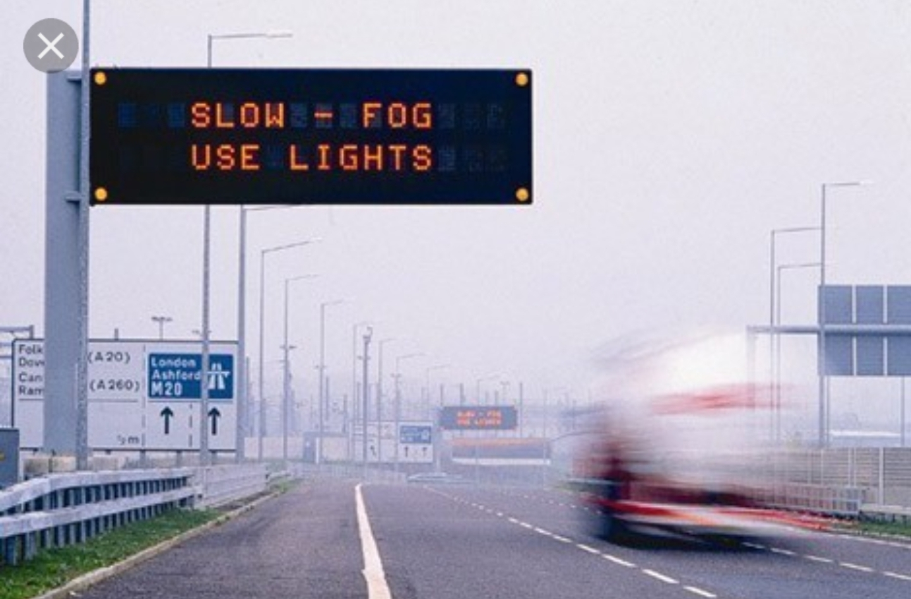
Notes:
- Pastor Mei Chin is teaching us to ask Holy Spirit for spiritual insights from physical situations
- Driving on the Freeway yesterday, the rain was heavy (I mean heavy), then on the sign board it read “CAUTION WET WEATHER DRIVE SAFELY WITH YOUR HIGHLIGHTS ON”
Something hit my spirit and the message I got and said to Dino “Wow I got a good message from that sign board”
Message: If the Holy Spirit within us does not lighten our hearts/life we are entering life in the dark; and even though there are caution signs, if people can’t see the light there is a grave danger for accidents.
Moral of the story: Switch on the light of the Holy Spirit within you, you can’t do life by yourself but you need the guidance of the Holy Spirit

